Slide 1
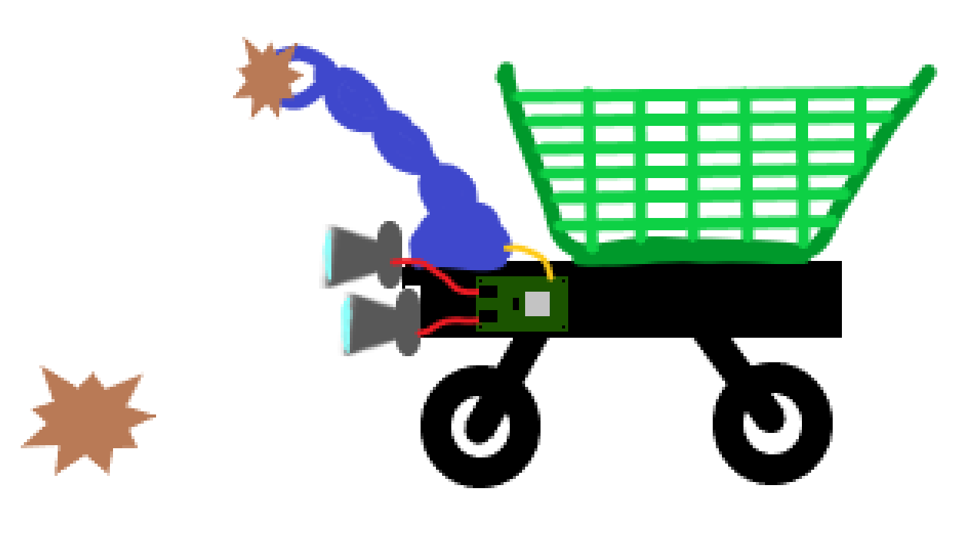
Stereo Visiual Odometry

Slide 2
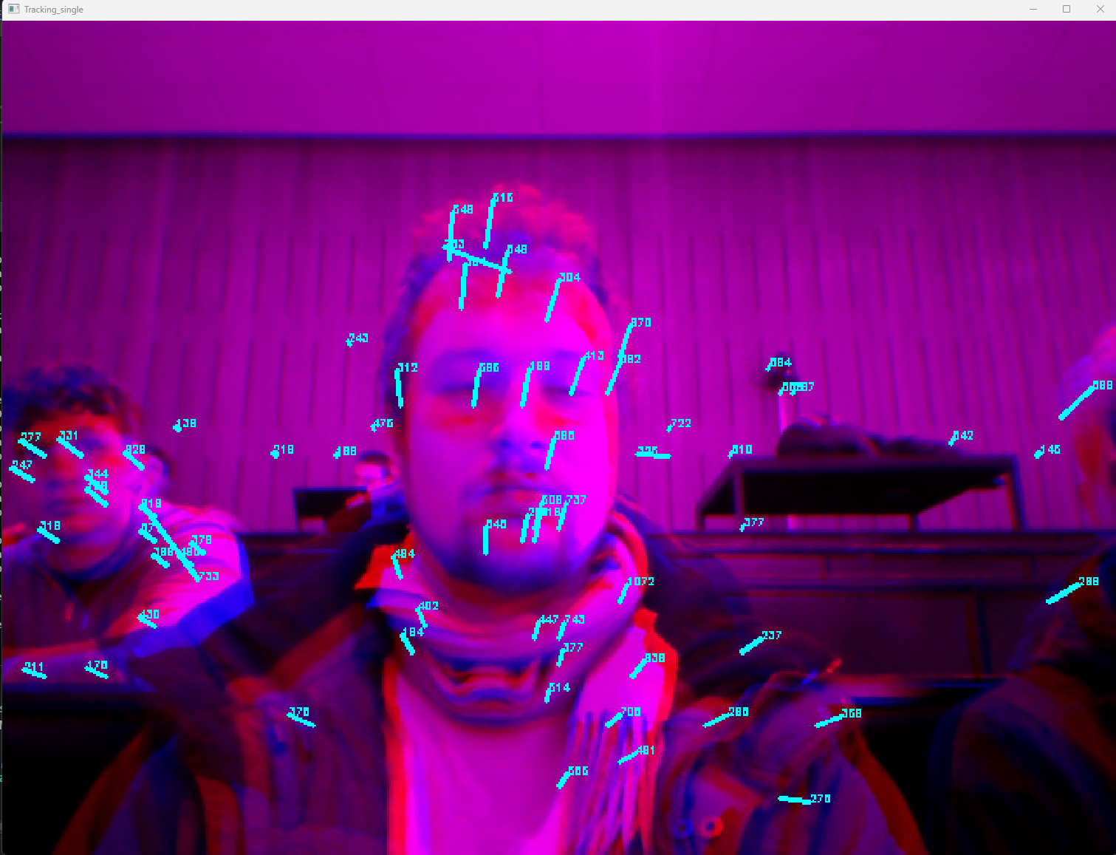
Old feature tracking approach
General trend is good
Works well but is slow

Slide 3
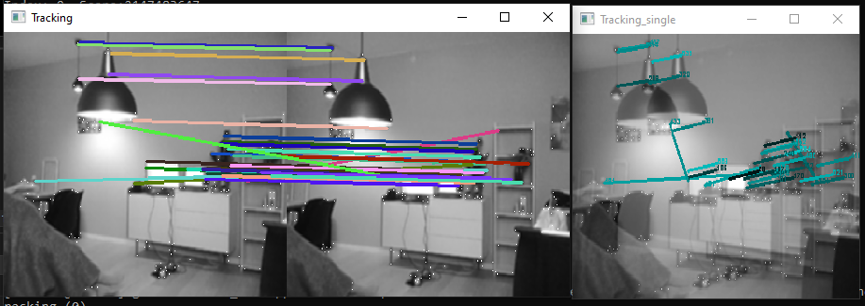
New faster approach
General trend is good

Slide 4
New faster approach
General trend is good
Previously
Run feature detection
Search for features in the new image close (1/3 image width) to the features of the old image
SLOW
Now
Run feature detection on both images
Compare features to each other and find the best matches
No longer a ‘blind’ search
10 times faster

Slide 5
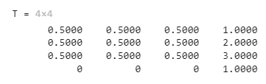
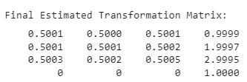
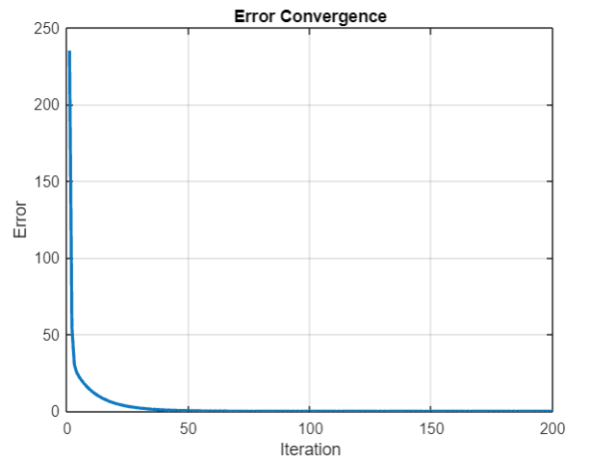
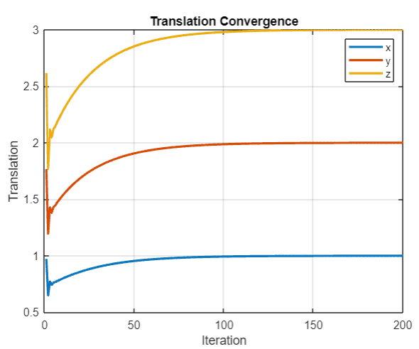
Motion Estimation – a new approach
Need to test with outliers
Compare to the other implementations

